Slide 1



Bi-directional vistor counter using PIR sensor
TEAM-04
Guided by
Prof - MANJUNATH. G

Slide 2



The Team
Uday
Nandini
Hasini
Rohith
ECE DEPARTMENT
ECE DEPARTMENT
ECE DEPARTMENT
ECE DEPARTMENT

Slide 3



Contents
Abstract
Introduction
Problem Statement
Tools Required
Proposed Methodology
Implementation
Advantages
Applications
Conclusion
Demonstration

Slide 4
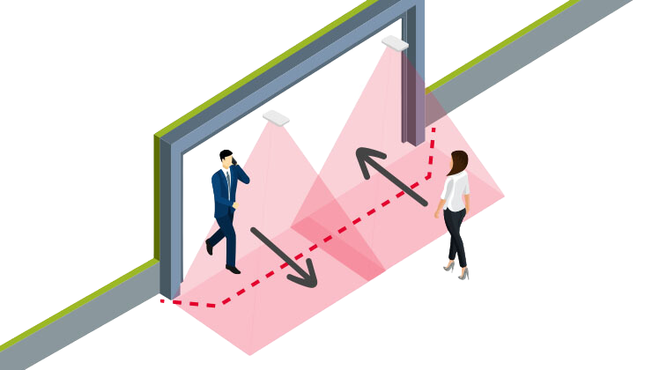
Abstract
The main objective of the mini project is to design a bi-directional visitor counter to count the number of people entering and exiting the area.
Making an ideal solution for managing crowd control and improving safety and security.
This project provides an informative and engaging overview of a bi-directional visitor counter using a PIR sensor.

Slide 5
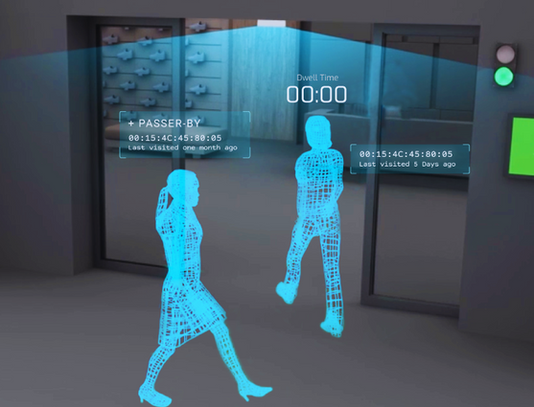
Introduction
Many times we need to monitor people visiting places like auditorium, hall, room, offices, malls, sports venue, etc.
Making an ideal solution for managing crowd control and improving safety and security.
To avoid this scenario and maintain safety and security we use this bi - directional visitor counter.

Slide 6


problem solving
1
2
3
Crowd Management
Safety and Security
Adjusting the temperature

Slide 7


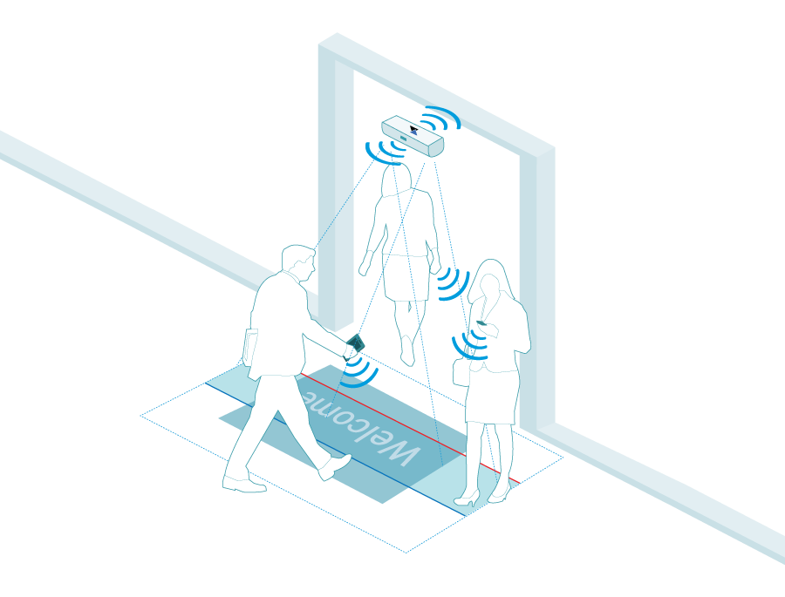
TOOLS AND LANGUAGES REQUIRED
LED Lights
potentiometer
resistors
Breadboard
LCD display (16*2)
Arduino
servo motor
PIR sensor
Piezo buzzer

Slide 8
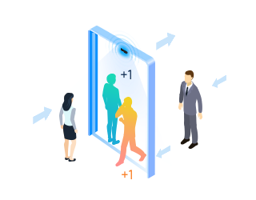

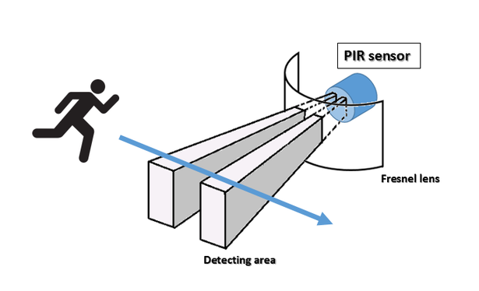
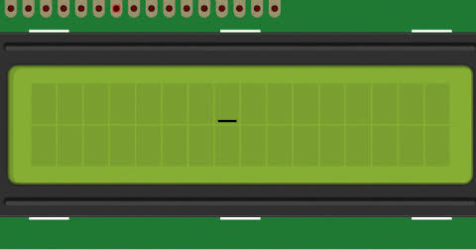
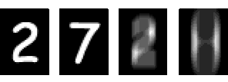
How it works ?

Slide 9

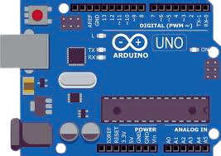
PROPOSED METHODOLOGY
SERVO MOTOR
LCD
Peizo buzzer
PIR Sensor 1
PIR Sensor 2

Slide 10
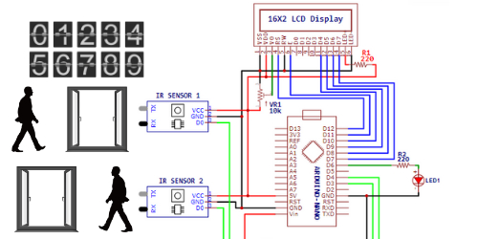
IMPLEMENTATION

Slide 11
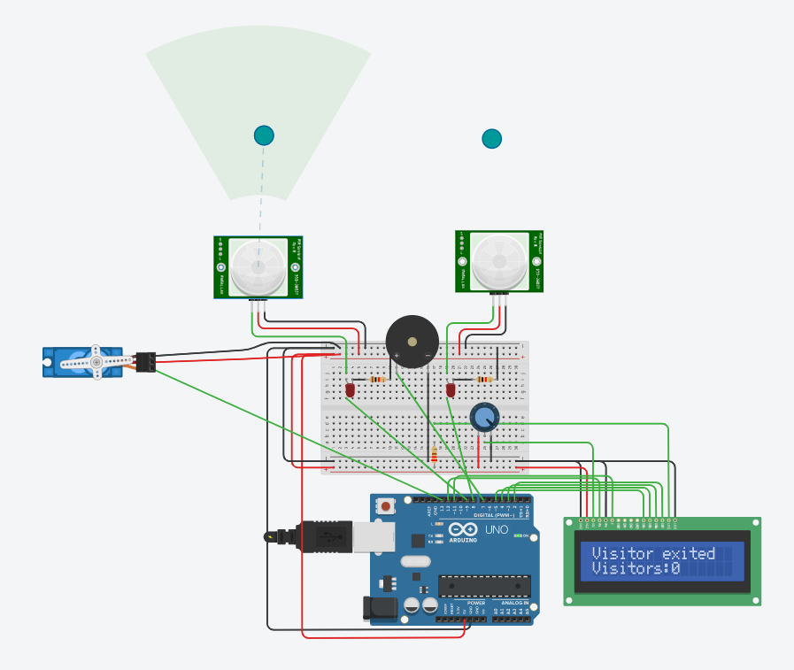
STEP 1 : DISPLAY USING LCD

Slide 12
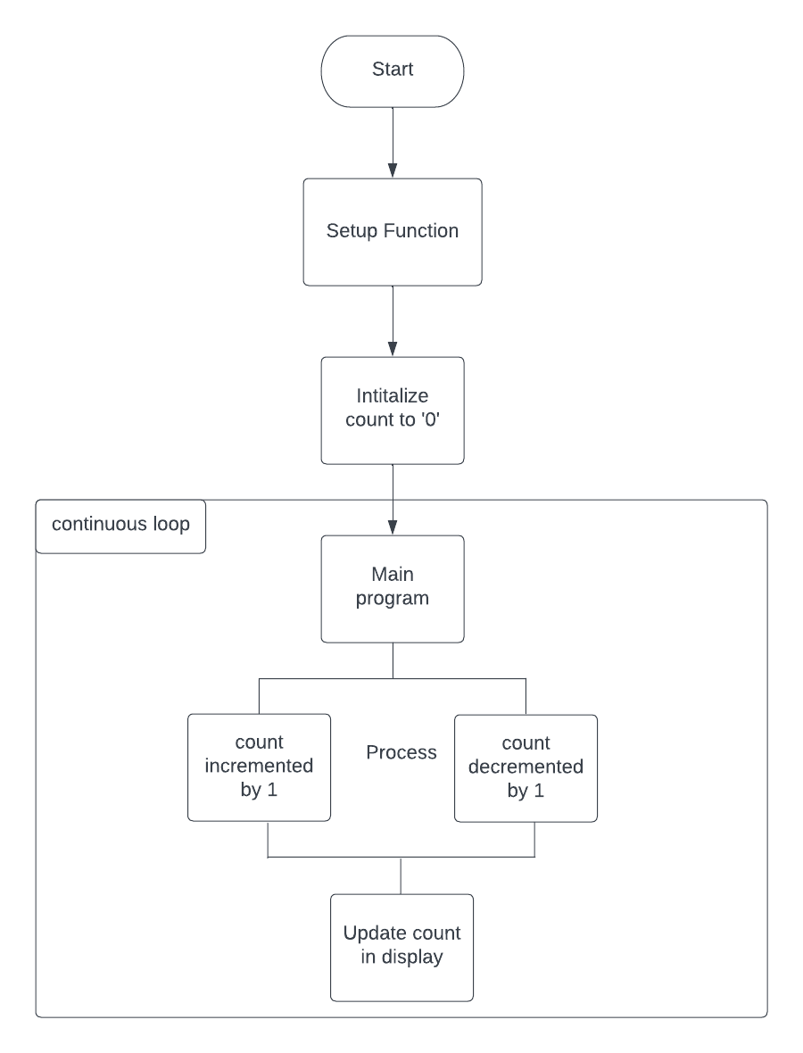
FLOWCHART

Slide 13
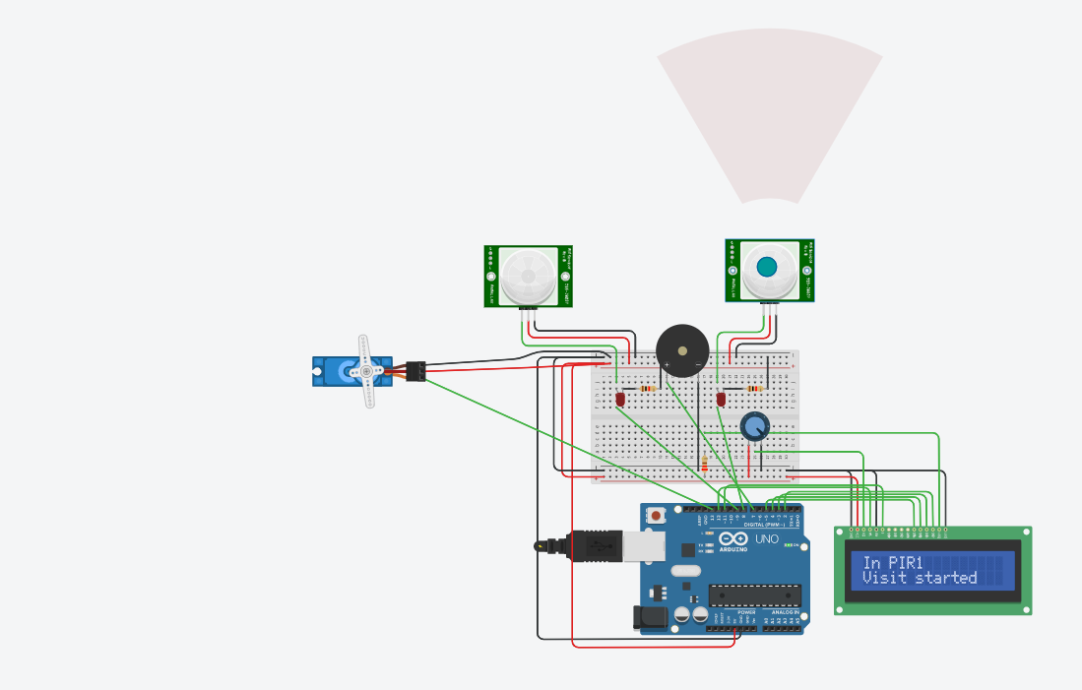
STEP 2: INTERFACING OF STEP 1

Slide 14
Accurate tracking
Cost effective
Advantages
Improved customer experience
Security

Slide 15

Applications
Retail stores
Hospitals
Museums
Airports

Slide 16
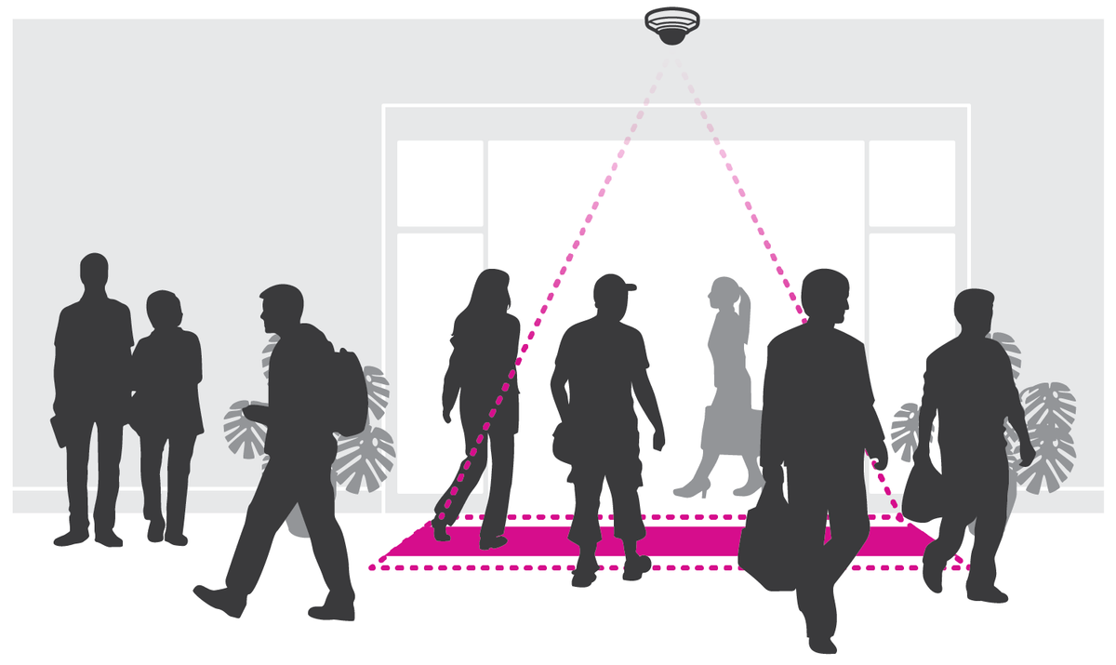
CONCLUSION
As we can conclude , Bi - directional visitor counter is a smart technology using IOT. It is an electronic device by implementing that counts the number of people entering and exiting a specific area. This type of counter is commonly used in various applications, such as in retail stores, libraries, museums, and other public spaces.
Hence this system should be cost-effective, easy to install, and capable of generating real-time data that can be used to optimize crowd management strategies.

Slide 17
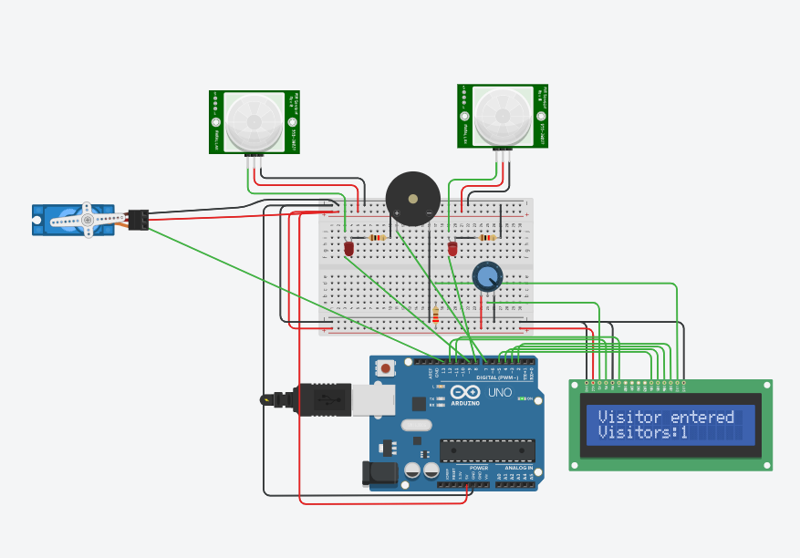
SIMULATION RESULT 1

Slide 18
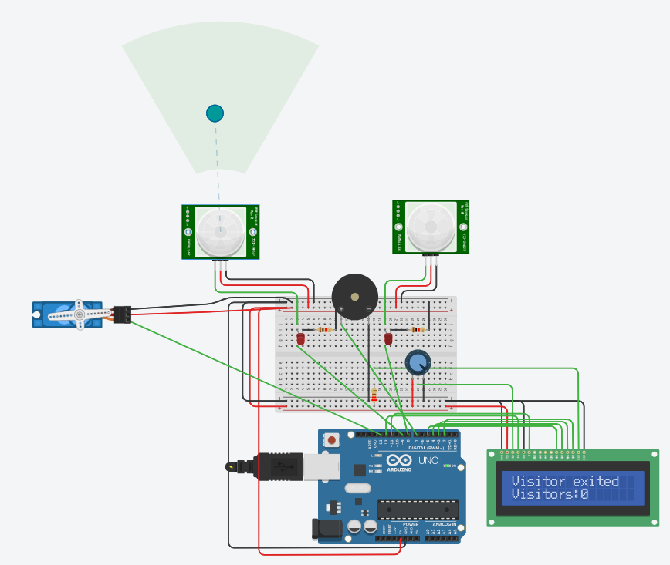
SIMULATION RESULT 2

Slide 19

DEMONSTRATION USING TINKER CAD

Slide 20
Thank You !

Slide 21
ANY
QUERIES ?

